Slide 1

OSM Tools

Slide 2
OSM has a diverse ecosystem
Difficult to know them all
Constant change – projects start and die
A tool for everything with different providers

Slide 3
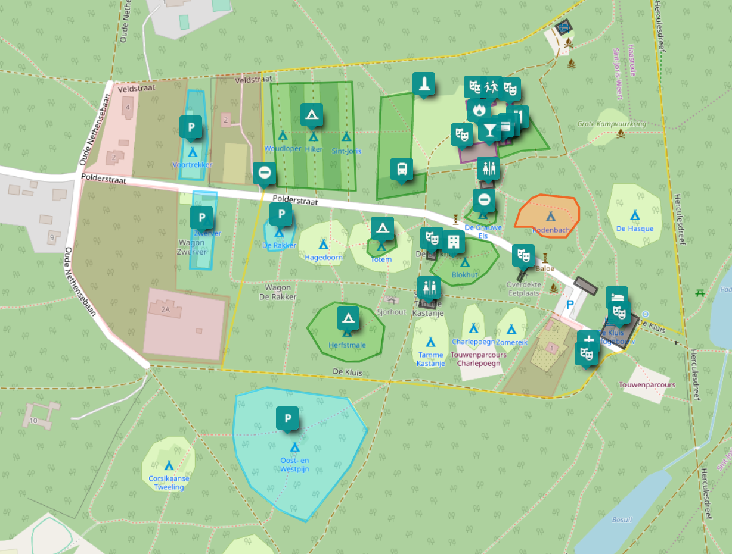
Umap.openstreetmap.fr
Ideal to add geodata not suited for OSM itself
  Preparing an event
  Planning an outing
  ...

Slide 4
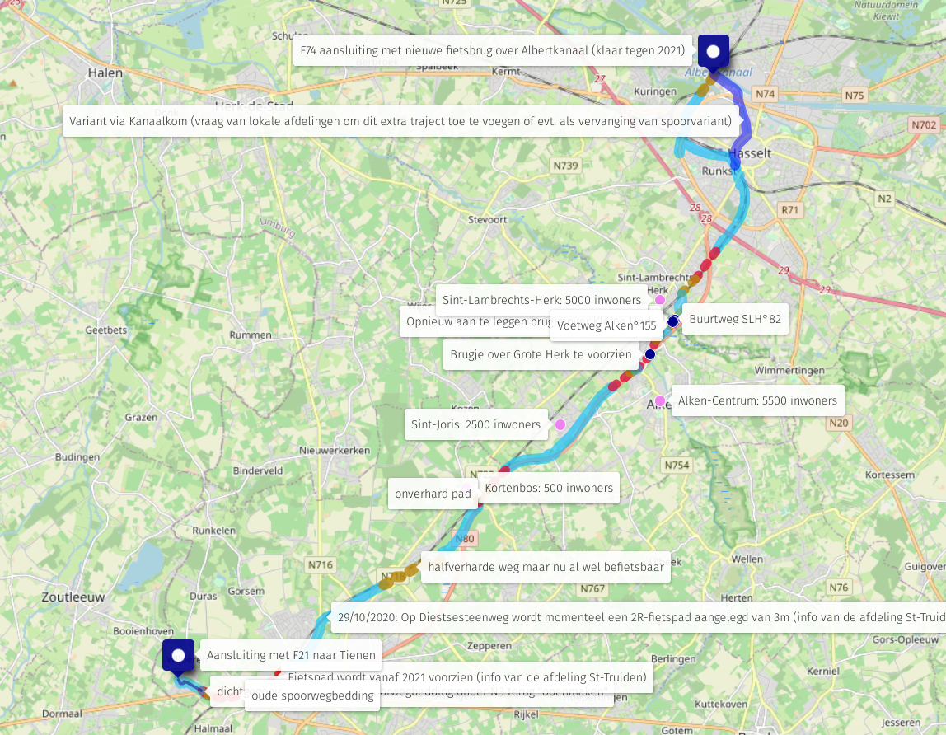
UMap

Slide 5
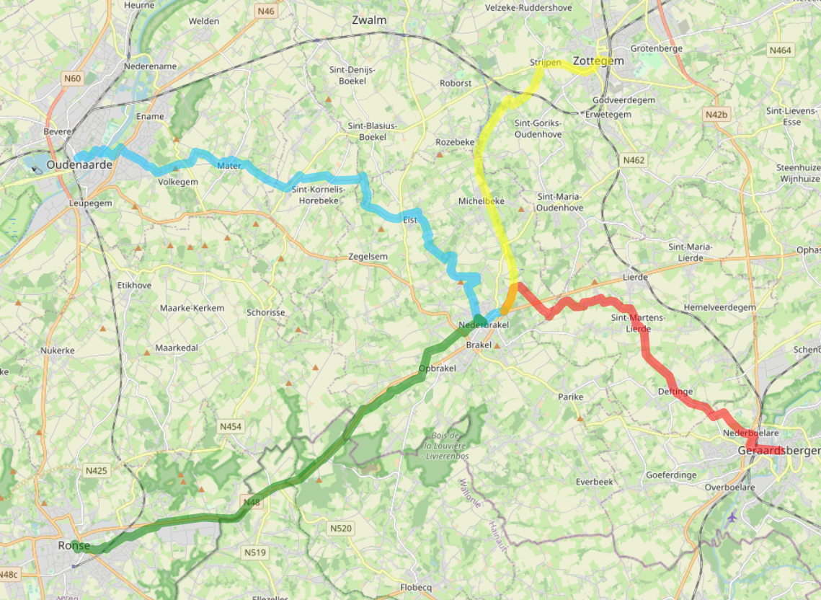
UMap

Slide 6
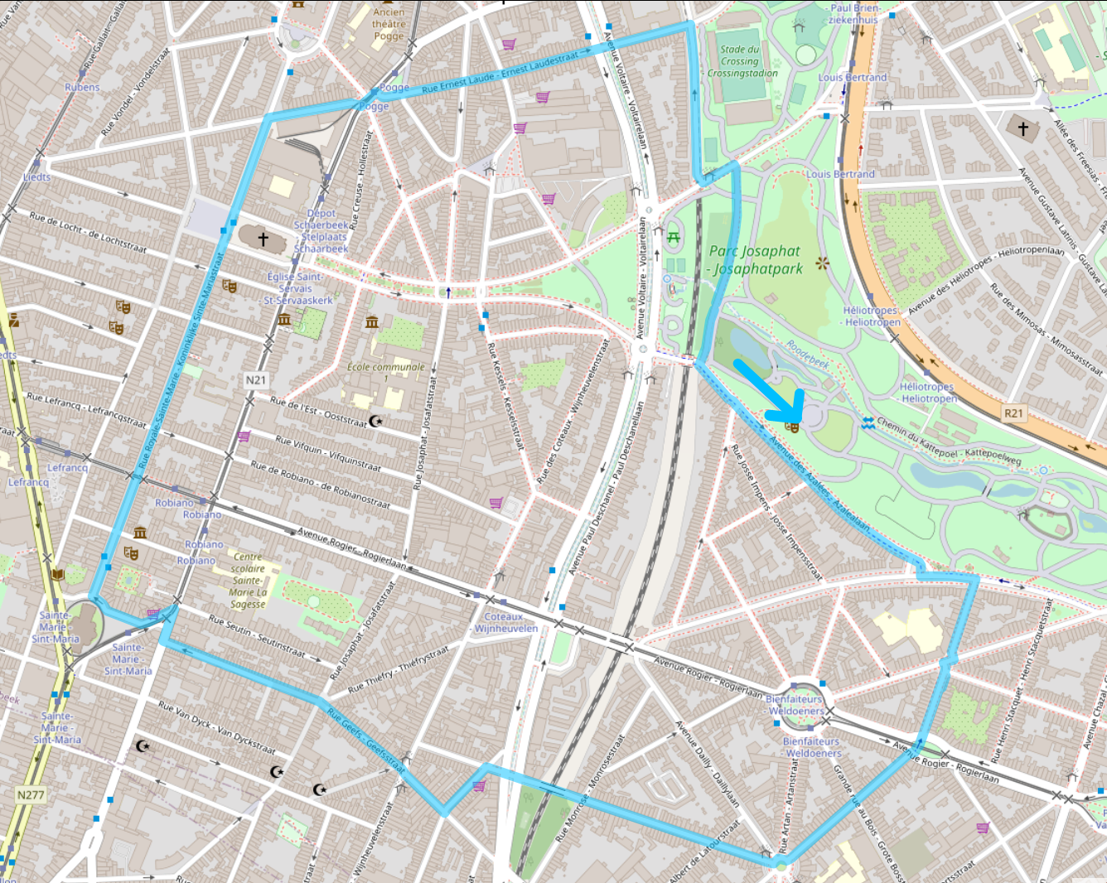
UMap

Slide 7
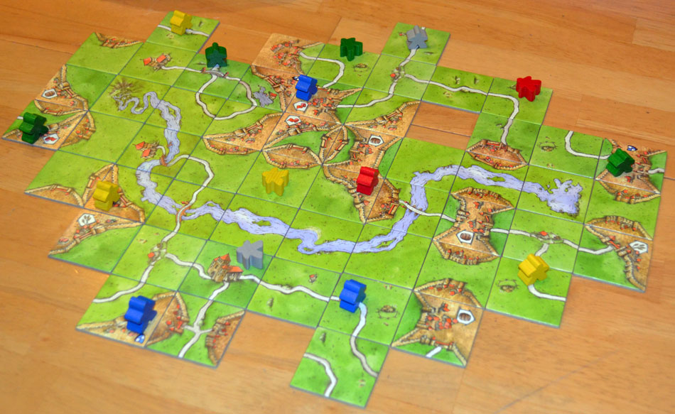
A webmap on your website

Slide 8
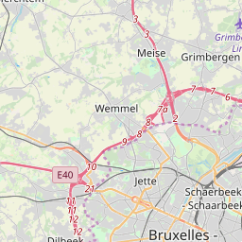
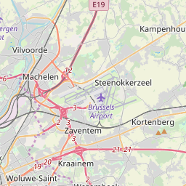
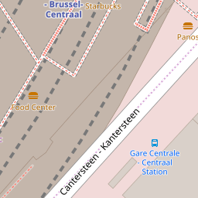
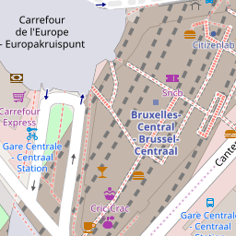
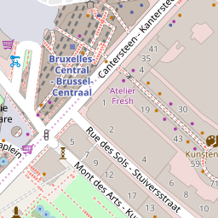
Slippy map
Also known as WMS ( Web Mapping Service), TMS (Tile Mapping Service) or WMTS

Slide 9
Slippy map: pro
One big computer takes all the data and creates lots of images for all zoom levels
Clients download these tiles
when they need them
Simple for the client
Lots of space needed on the central computer
Static (style changes?)

Slide 10
Slippy map: con
Lots of space and internet needed on the central computer
Internet is required for the client
Leaks sensitive private data – trust the provider
Central point of failure
Static (style changes?)

Slide 11
Tile providers
Hobby/small projects: osm.org
Belgium only: Geo6 (see osm.be)
Big projects: commercial providers
  Mapbox
  Maptiler
Non-OSM layers with aerial/sattelite
  Flanders: AIV (also: GRB, older layers)
  Wallonia: SPW
  Mapbox/ESRI/Bing/Maxar
See https://switch2osm.org/providers/

Slide 12
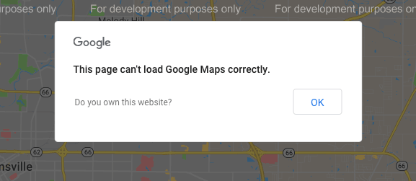
Tile providers

Slide 13
Slippy map
We know where to get the tile images…
But how to neatly show them?

Slide 14

Leafletjs.com
Small & friendly JS-library

Slide 15
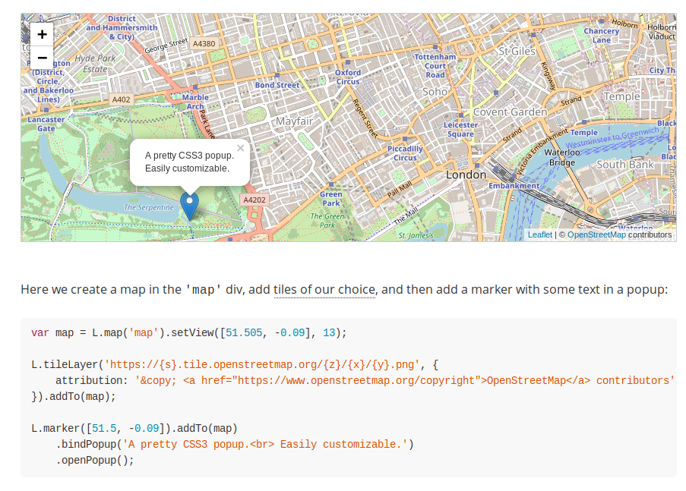
Leafletjs.com
Small & friendly JS-library

Slide 16
Leafletjs.com
Small & friendly JS-library
Read their docs! They are awesome!

Slide 17
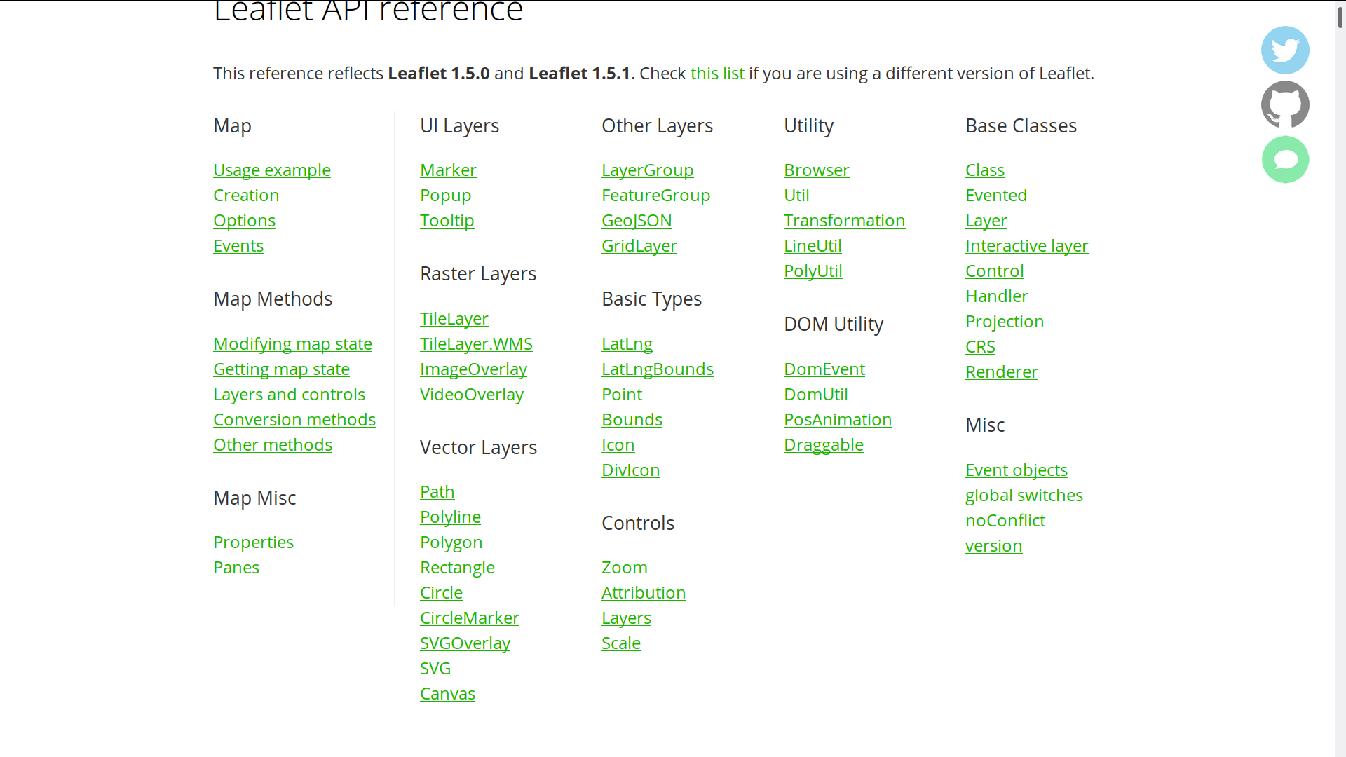

Slide 18
Mapbox GL JS (MapLibre?)
Sends vector tiles to the client (instead of PNG’s)
More possibilities, but harder to set up
Tied to Mapbox as provider (not FLOSS since version 2.0)

Slide 19

Getting specific data

Slide 20
Getting specific data
Where are all the chimneys/hairdressers/roads with cobblestone/… in … ?
Ask overpass!

Slide 21
Overpass
Easily query the OSM-database
Can be used to create an on-the-fly, automatically up-to-date map*
Lots of complicated features
10’000 queries/(day*project)
(* often a few minutes behind osm.org)

Slide 22
Overpass-turbo.eu
Where are all the chimneys/hairdressers/roads with cobblestone/… in … ?
Ask overpass!

Slide 23
Using overpass-turbo
Lookup the tag(s) on wiki.osm.org
Go to overpass-turbo.eu
Click ‘wizard’
Enter your query
  highway=* & surface=*
  natural=water | water=*
  natural=tree in Brussels
  …
Click ‘Build and run query’

Slide 24
Using overpass-turbo
Users of DuckDuckGo:
!wosm bicycle parking
!otw amenity=bicycle_parking
Done

Slide 25
Using overpass-turbo
Click ‘export’ to save as
GeoJson, GPX, XML, …
… or to get a URI to query in another app
  (such as JS to pass it to Leaflet)
Click ‘share’ to share with others

Slide 26
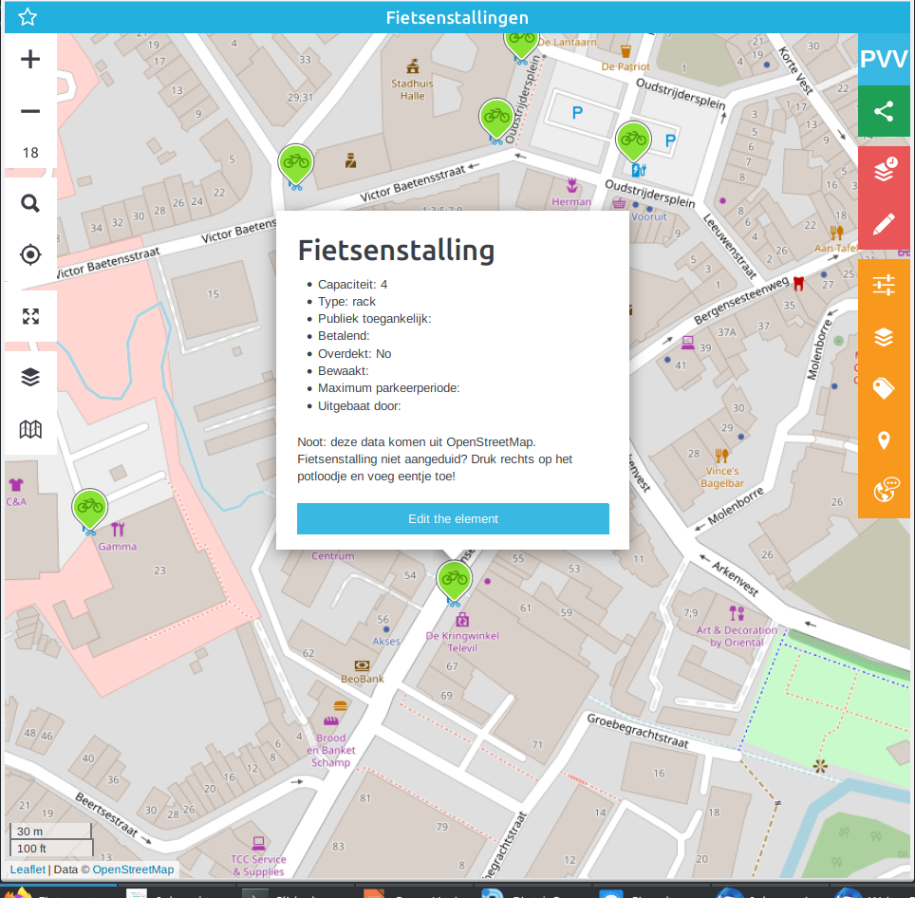
MapContrib
Visualises a query
Allows to add data easily
Easy to help surveying

Slide 27
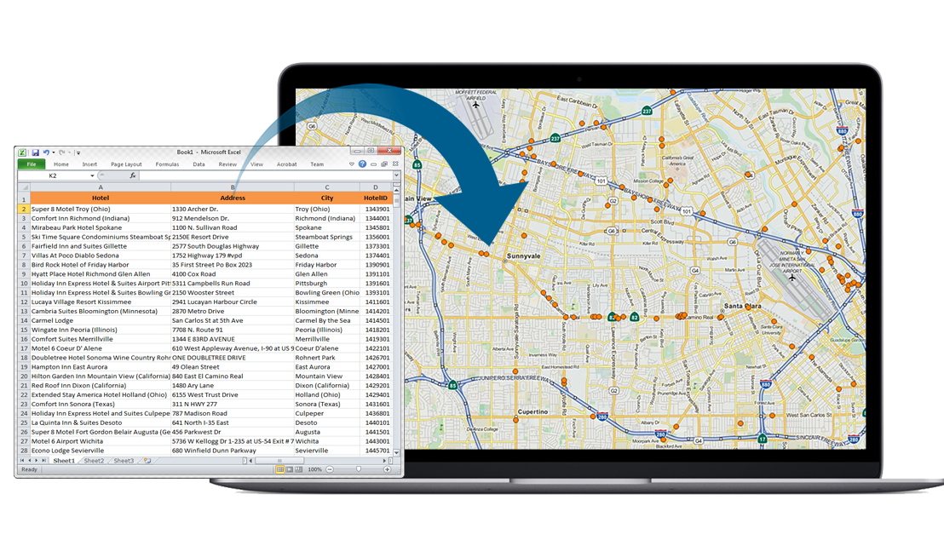
Geocoding

Slide 28
Geocoding
Convert an address string into a coordinate
  Or reverse geocoding: what is close to a coordinate?
Hobby projects: use nominatim.osm.org
Big projects: contact a commercial player
  See switch2osm.org

Slide 29
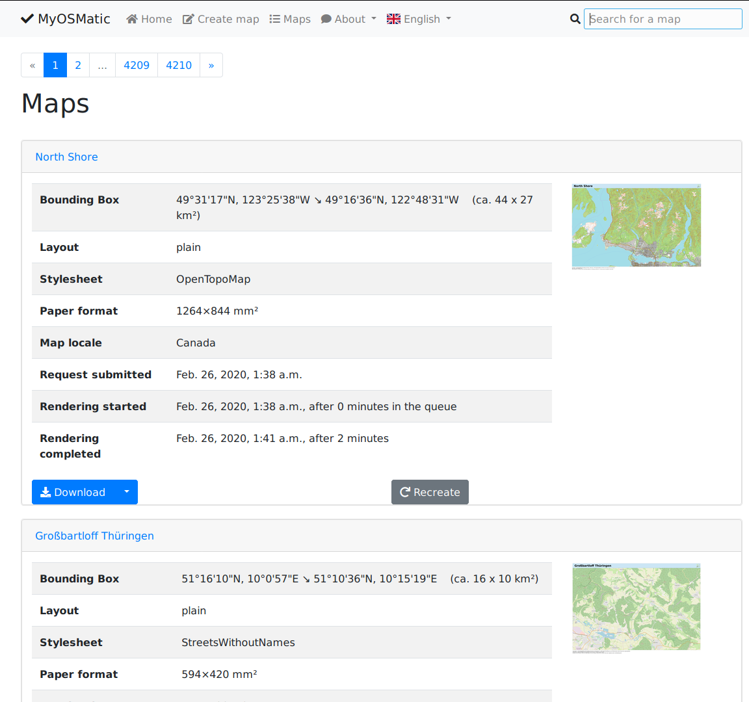
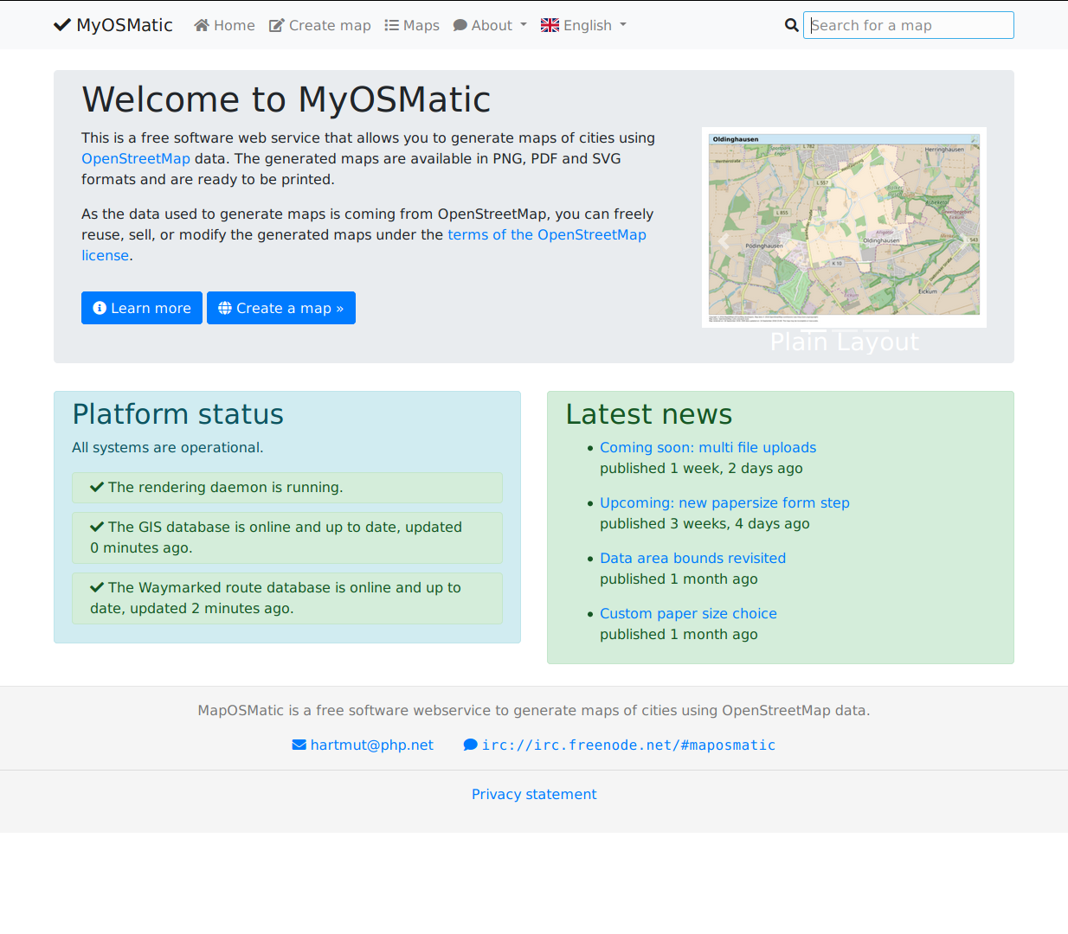
On paper: maposmatic

Slide 30
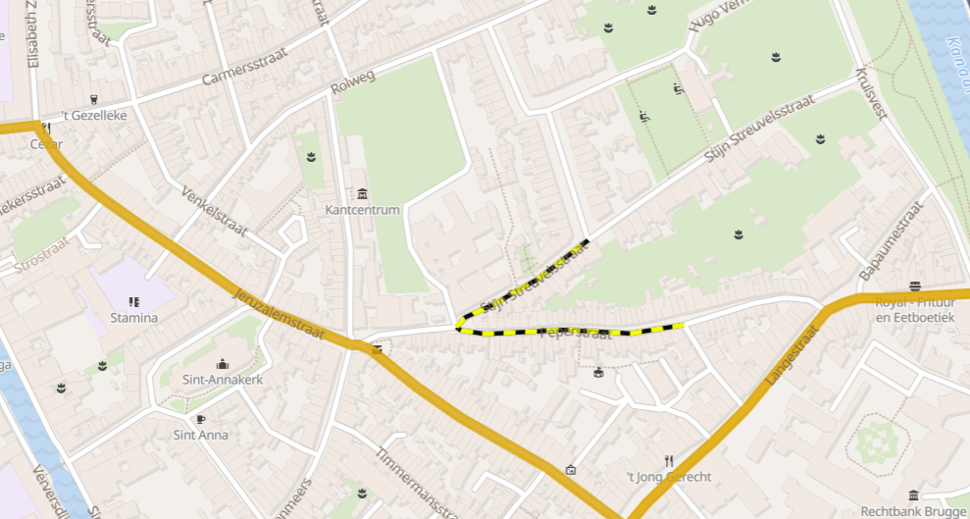
Mobility analysis sandbox to experiment
Disclaimer:
this is slide is shameless self-promotion
for anyways.eu

Slide 31
3rd party route planning
Providers exists who do route planning (we are one)
Hobby projects: see the graphhopper instance
Bigger projects: search a commercial provider (e.g. anyways.eu)…

Slide 32

On your phone!

Slide 33
On your phone!
An app for every usecase
Some are simple, some have tons of features
Some are paid, some are “free”
Some focus on cyclists, hikers, vegetarians, ...
Some are playful! (#PoGo)
Some are crappy

Slide 34
Navigation apps
OsmAnd
Maps.me
Magic Earth
…

Slide 35
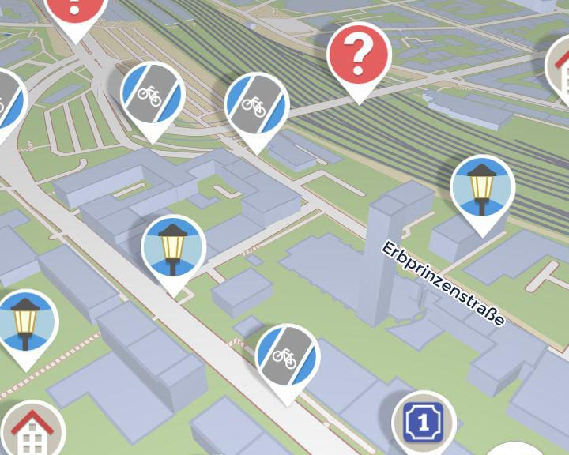
StreetComplete
Add information on the go
Only updates tags
Cant make new ways or points
Excellent first contributor tool

Slide 36



OsmAnd

Slide 37
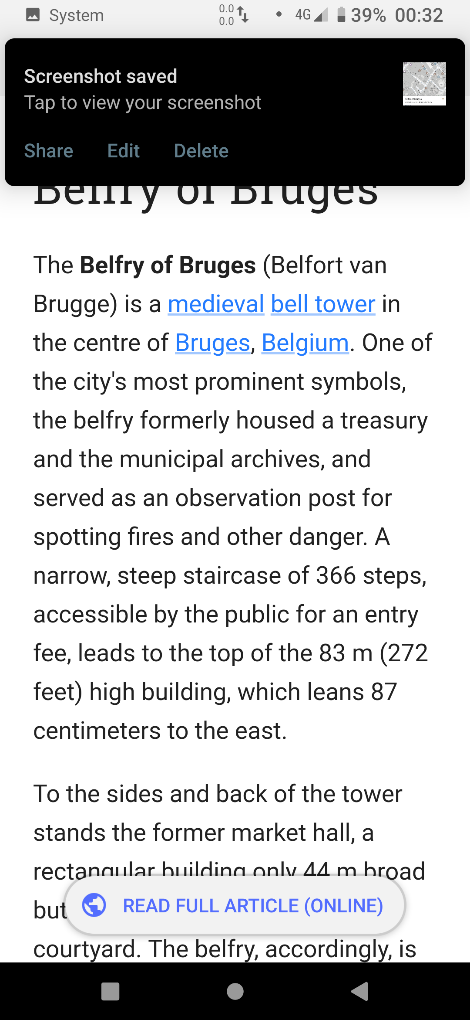
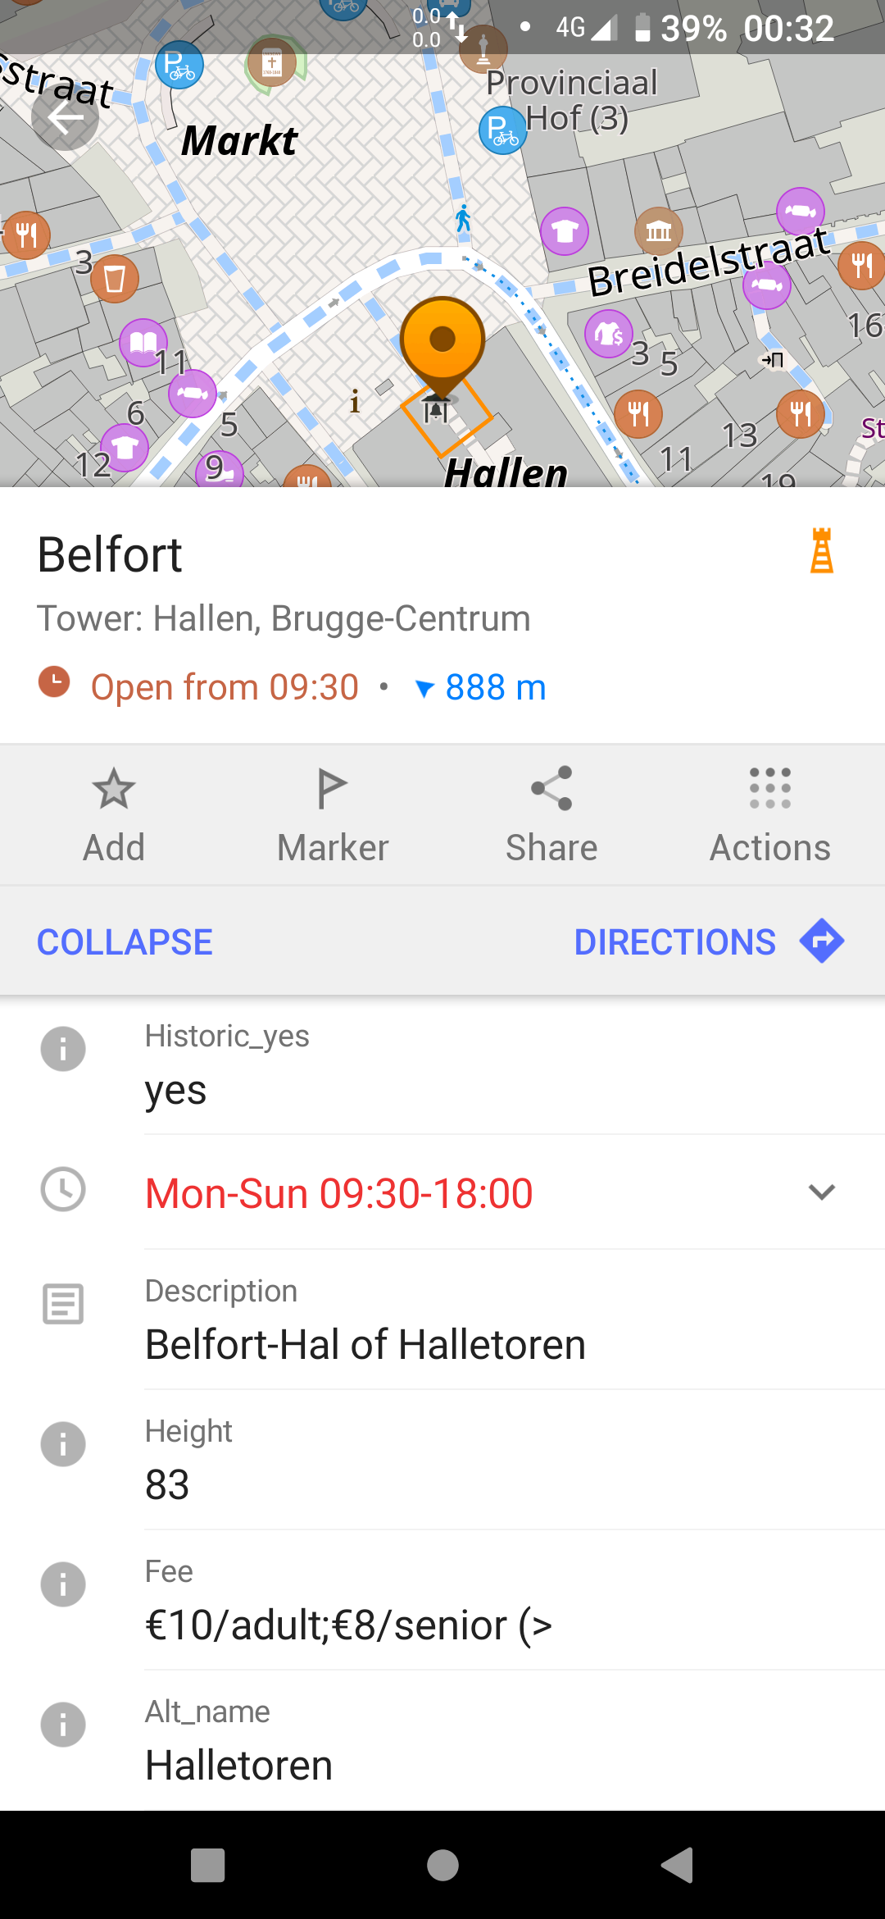
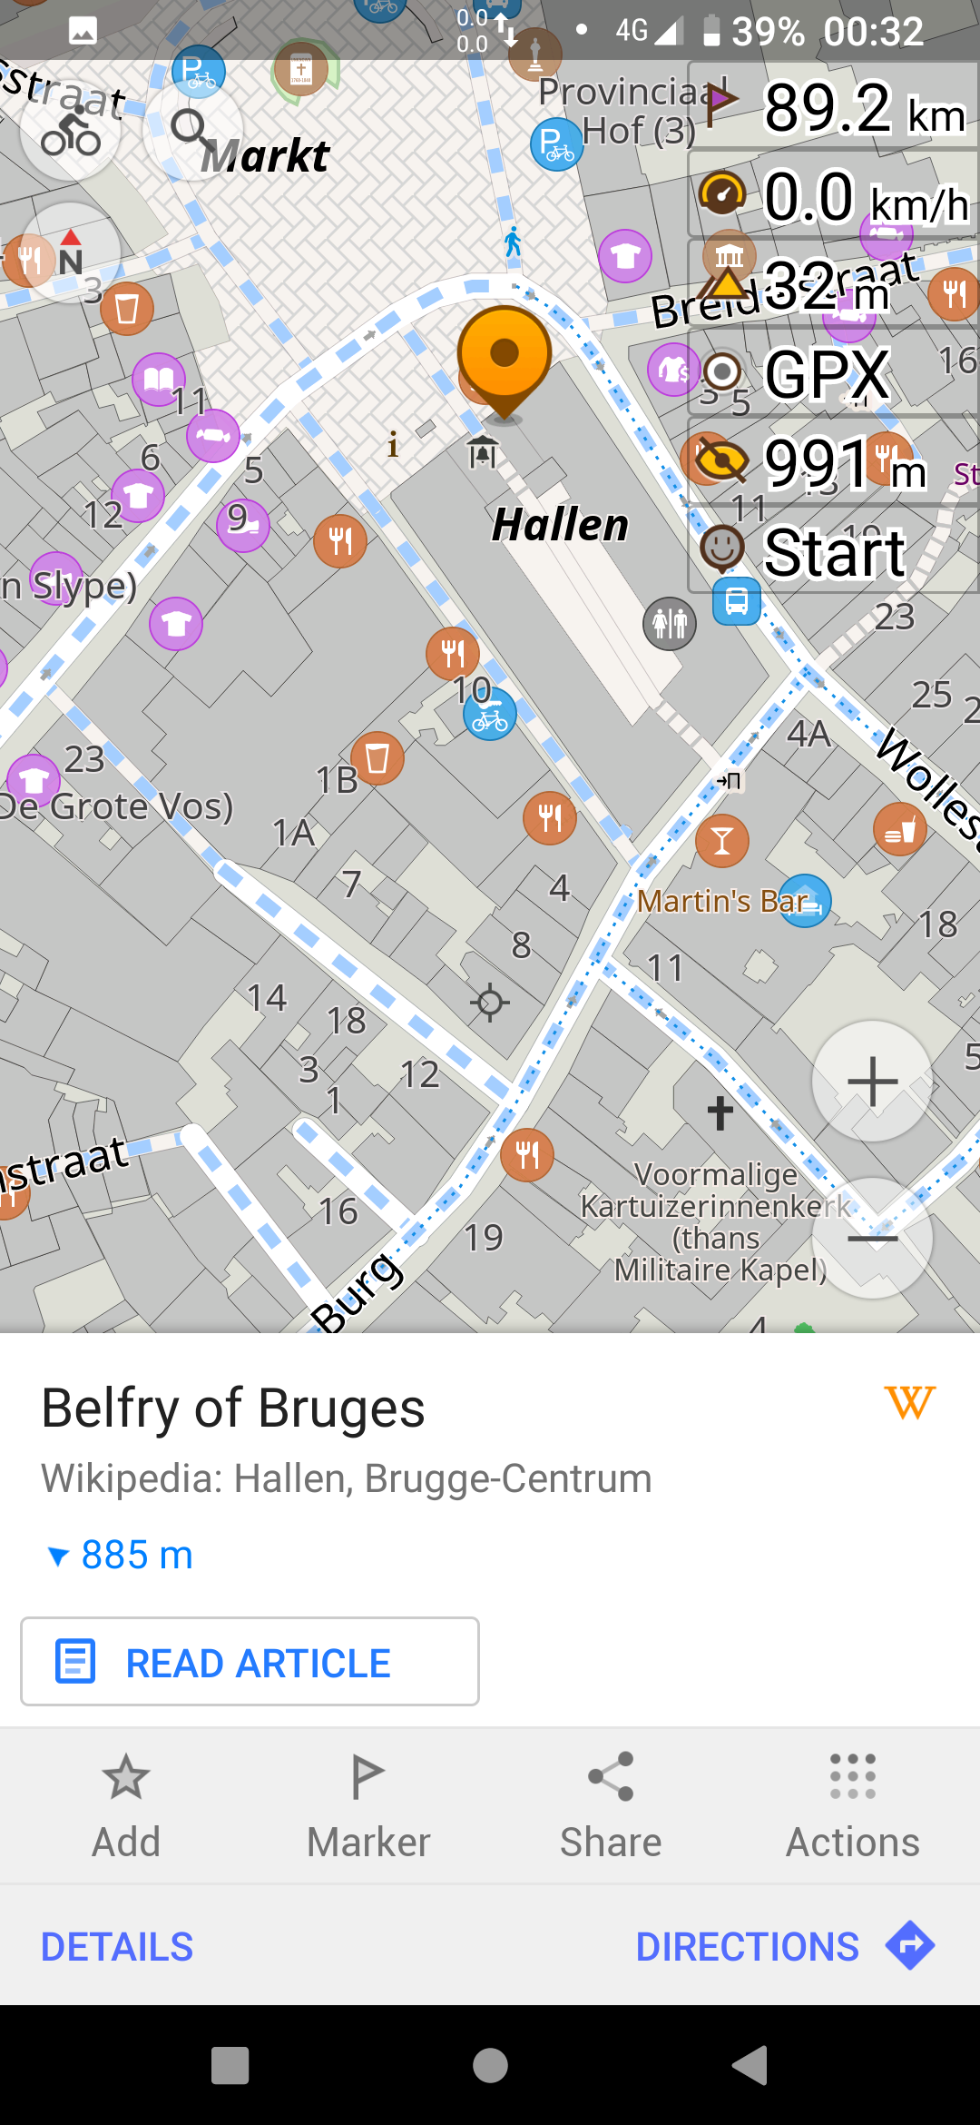
OsmAnd

Slide 38
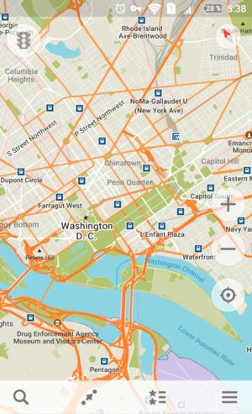
Maps.me

Slide 39
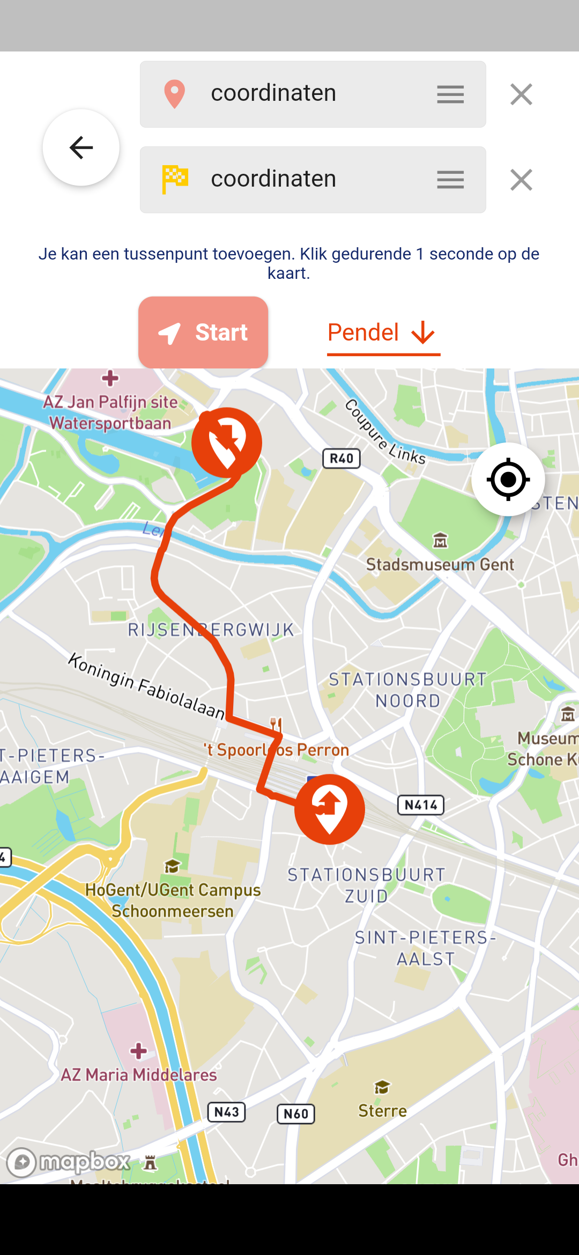

Bike To Work-app

Slide 40
OSM

Slide 41
OSM has a diverse ecosystem
Difficult to know them all
A small personal webmap: UMAP
Need data: Overpass-turbo.eu (and the wiki)
Routeplanning is nuanced and very subjective

Slide 42
OSM has many editors
Cyclofix/MapComplete on the go
iD for advanced editing
JOSM for power users who are familiar with GIS
  Ask for help to get started

Slide 43
OSM has many contributors
We are a cool bunch, with all our interests
  Nature, mobility, routeplanning, cars, shops,
which we put on our big, open map
We welcome everyone who wants to help out or needs our data

Slide 44
Open Data is changing the world
Improving our lives closeby
Saving lives far away

Slide 45
Come and join us!

